Slide 1
Deployment – Live Trading

Slide 2


Slide 3
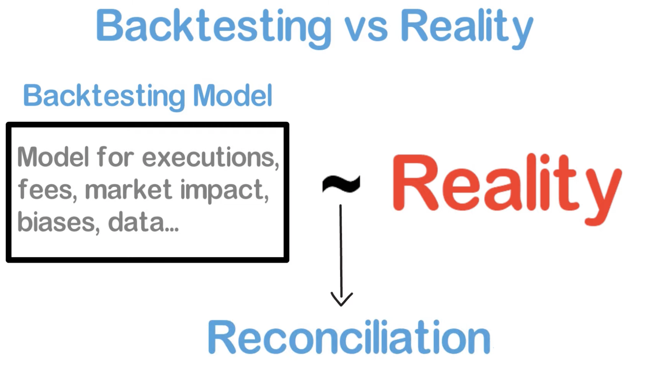

Slide 4
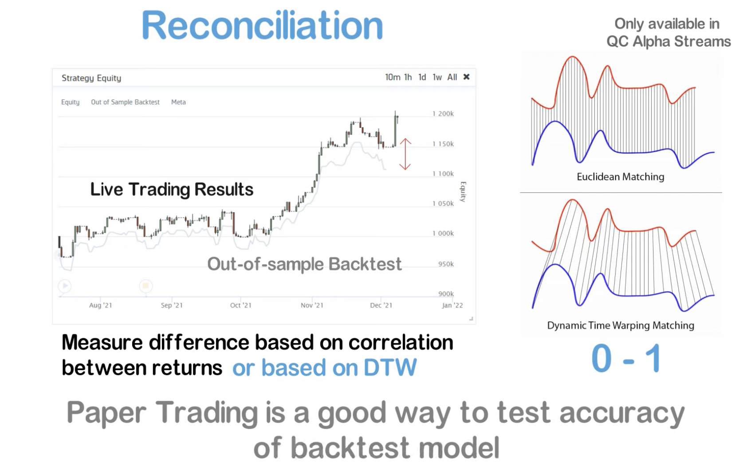

Slide 5
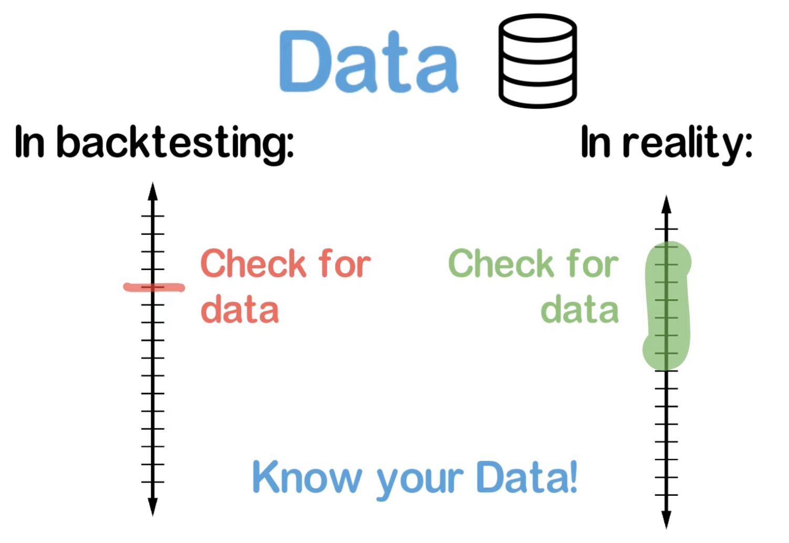

Slide 6
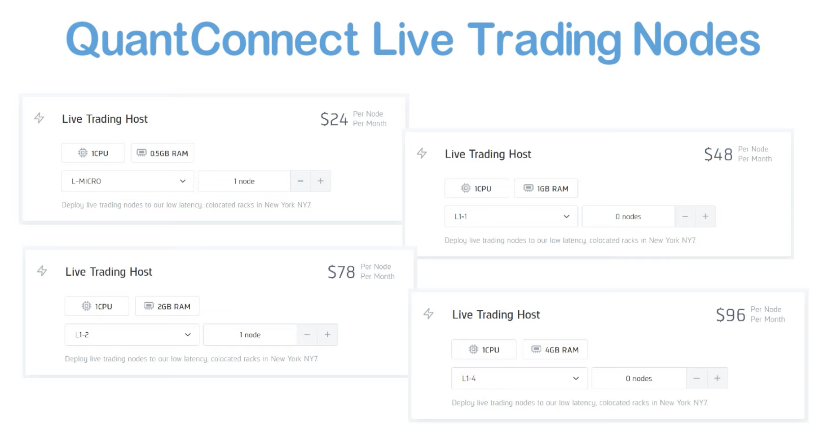

Slide 7
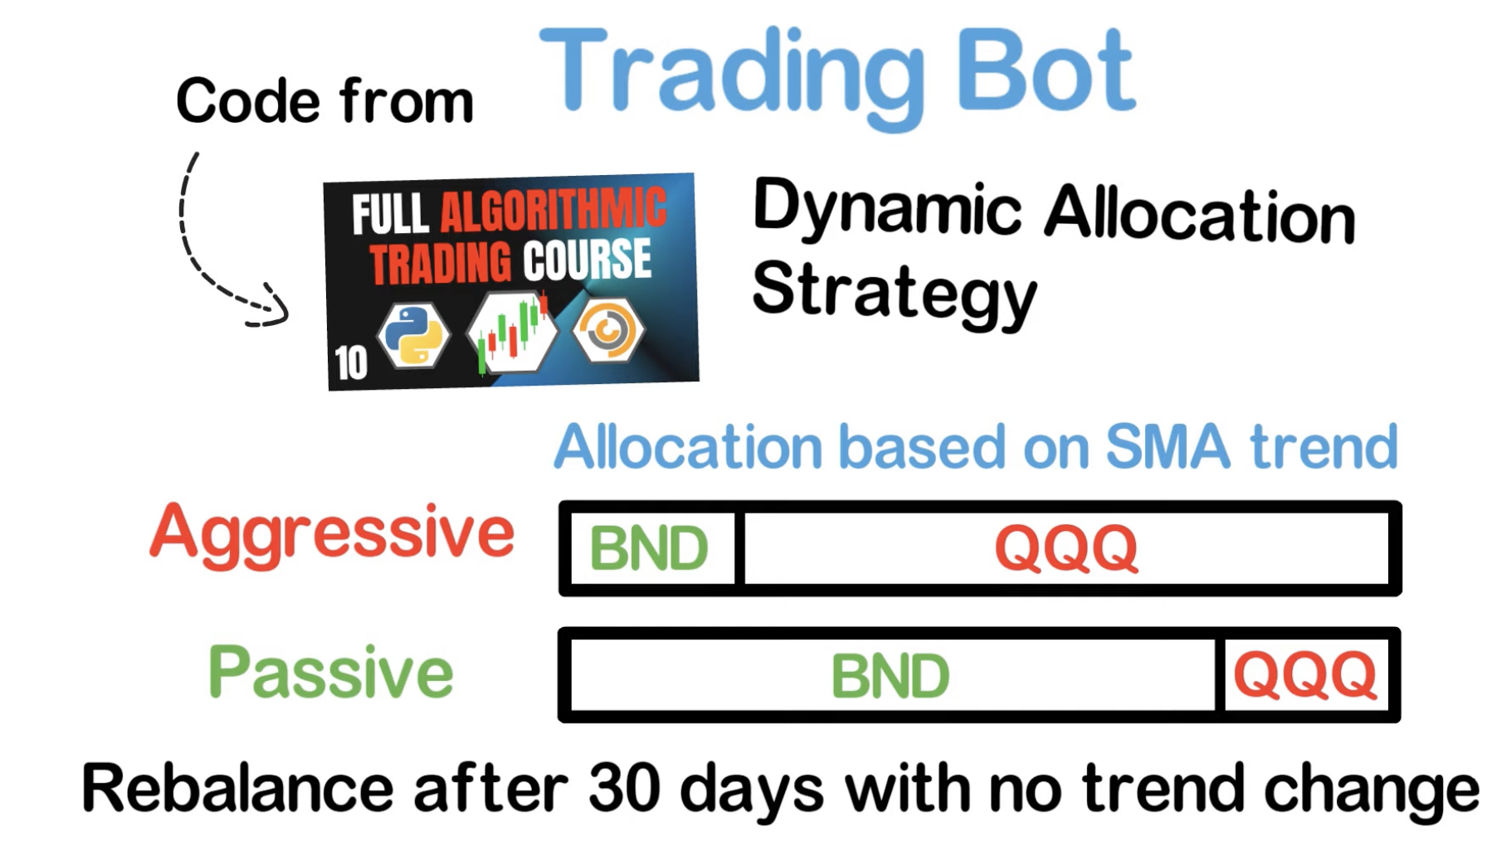

Slide 8
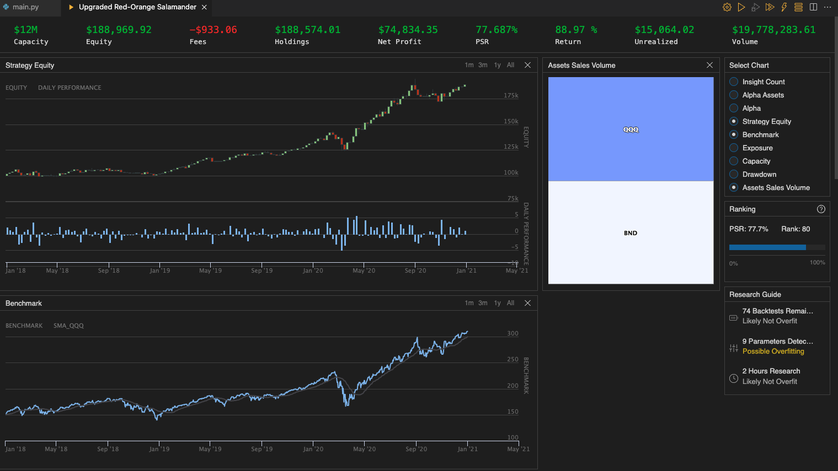

Slide 9
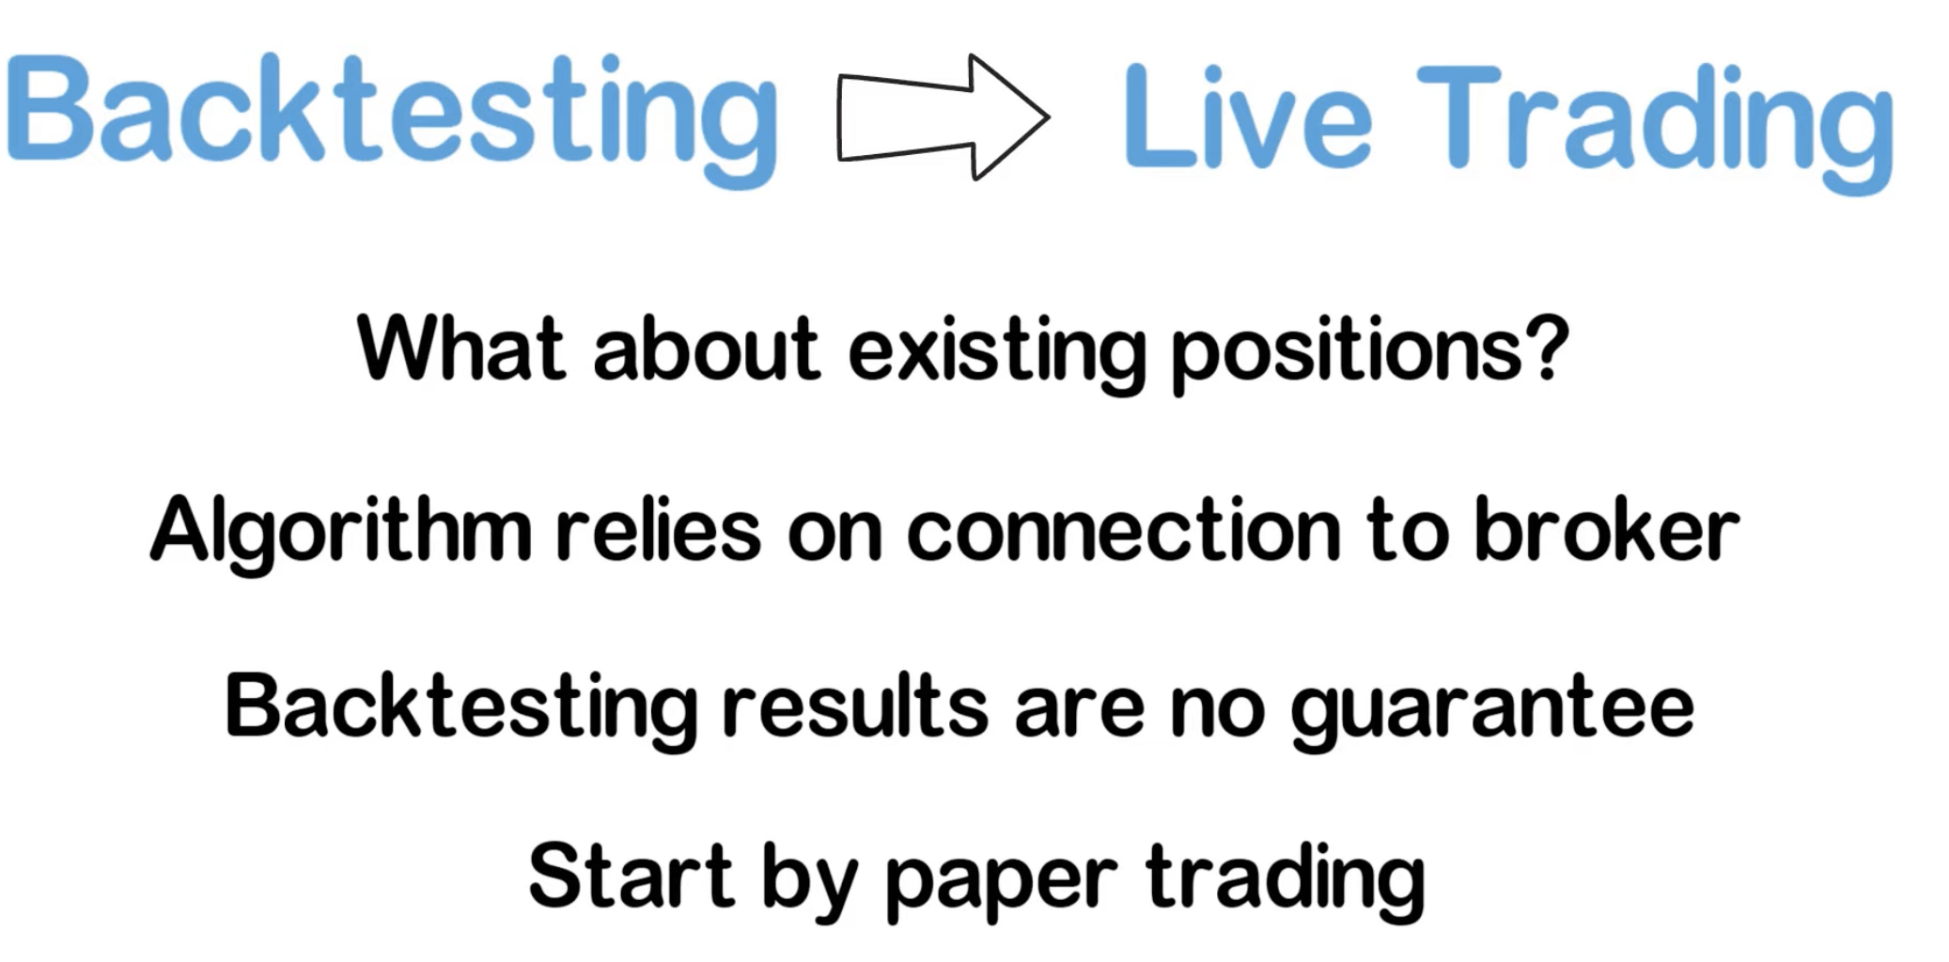

Slide 12
Live Trading Docs: https://www.quantconnect.com/docs/live-trading/overview?ref=towm

